Slide 1
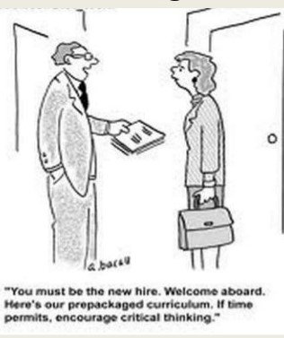
Critical Thinking in the Classroom
Brian Bird
GCC Math Faculty
Spring 2018

Slide 2
Critical Thinking Defined
According to John Dewey, critical thinking is reflective thought in which you suspend judgement, maintain a healthy skepticism, and exercise an open mind. It requires an active, persistent and careful consideration of any belief in light of the ground that supports it. It has both intellectual and emotional components.

Slide 3
Critical Thinking Defined
“Critical thinking is the art of analyzing and evaluating thinking with a view to improving it” via Paul and Elder
“Purposeful, reflective judgment which manifests itself in reasoned consideration of evidence, context, methods, standards, and conceptualization in deciding what to believe or what to do” via the Delphi Report

Slide 4


Delphi Report
International group of experts (46 men and women from USA and Canada) from different scholarly disciplines tried to form a consensus about the meaning of critical thinking
Lasted 2 years (Feb 1988 to Nov 1989)
On behalf of American Philosophical Association

Slide 5
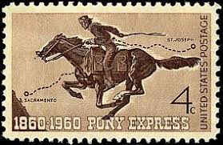
The Delphi Method
Developed to enable experts to think effectively about something over large spans of distance and time
Central investigator organizes the group and feeds them an initial question
Central investigator receives responses, summarizes them, and transmits them back for reactions, replies and additional questions

Slide 6
Cognitive Skills and Sub-Skills
Interpretation
Categorization
Decoding Significance
Clarifying Meaning
Analysis
Examining Ideas
Identifying Arguments
Analyzing Arguments
Evaluation
Assessing Claims
Assessing Arguments

Slide 7
Cognitive Skills and Sub-Skills (cont)
4. Inference
Querying Evidence
Conjecturing Alternatives
Drawing Conclusions
5. Explanation
Stating Results
Justifying Procedures
Presenting Arguments
6. Self-Regulation
Self-examination
Self-correction

Slide 8
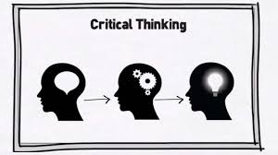
IDEAS Acronym for 5 Step Problem Solving Process
I=Identify the problem and set priorities
D=Determine relevant information and deepen understanding
E=Enumerate options and anticipate consequences
A=Assess the situation and make a preliminary decision
S=Scrutinize the process and self-correct as needed

Slide 9

Classroom Strategies
Mini-lecture activity sandwich
Short introductory lecture
Group activity
Short summative lecture
Student participation and peer interaction are correlated positively with improved critical thinking
Cut 20% out of lecture and allow for group activities
Students can be held accountable for topics not covered in class

Slide 10

Effective Group Traits
Positive interdependence
Personal responsibility and individual accountability
Reflection on group process
Conflict management
Group operating procedures

Slide 11

Group Size and Structure
4 or 5 seems to work best – everyone can contribute and if one person is absent it is not a big deal
Permanent of Temporary (depends on size and layout of class)
Heterogeneous (i.e. diverse) groups via random or non-random methods

Slide 12
Suggested Group Activities
Write an exam question and a rubric to grade it
Switch notes, review, and critique
Individually develop a question on the mini-lecture then answer each others questions
Teach each other a concept slightly beyond the mini-lecture
Group presents solution to problem presented by teacher to entire class

Slide 13

Benefits of Cooperative Groups
Research shows that cooperative learning groups yield:
Higher student achievement
Increased critical thinking
Greater student satisfaction
Lower attrition
Higher self esteem

Slide 14
References
https://www.insightassessment.com/Resources/Importance-of-Critical-Thinking/Critical-Thinking-What-It-Is-and-Why-It-Counts/Critical-Thinking-What-It-Is-and-Why-It-Counts-PDF
https://stearnscenter.gmu.edu/wp-content/uploads/2012/08/12-The-Delphi-Report-on-Critical-Thinking.pdf
https://eric.ed.gov/?id=ED315423
http://www2.gsu.edu/~dschjb/wwwcrit.html

